Slide 1
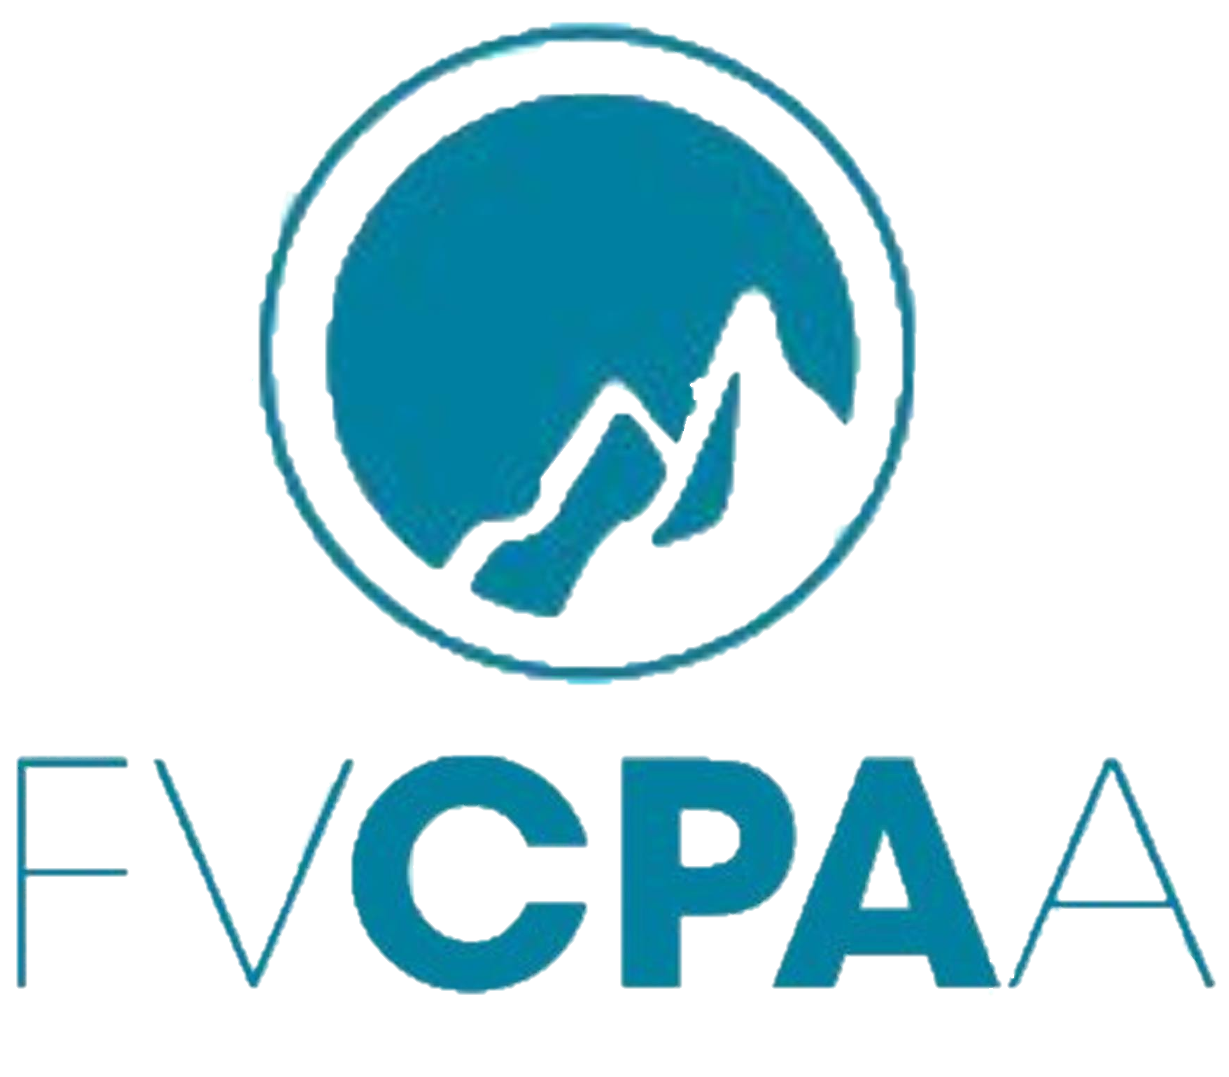
Cross Border Business Landscape
Making Lives Better, Businesses Stronger
9/24/25

Slide 2

Agenda
Welcome and Introduction
Impact - OBBBA
Impact - US Tariffs
Impact - WA State and Local Tax
State and Local Income Tax – Overview
Q&A

Slide 3
Welcome and Introduction

Slide 4


Our Team
Drew Chapman
Manager
Orion Mark
Senior Manager

Slide 5
About Larson Gross
Notes:
Larson Gross CPAs & Consultants is the tenth largest public accounting firm in the Puget Sound, serving U.S. and Canadian individuals and businesses with ...

Slide 6
Impact – OBBBA
What Foreign Investors and Canadian Companies Need to Know About the Impact of the OBBBA

Slide 7


What is the One Big Beautiful Bill Act (OBBBA)?
Brief overview: Passed July 4, 2025.
Compared to the much larger “TCJA” from 2018, OBBBA is more of an extender, but with several new items thrown in.
Represents a shift in U.S. fiscal direction in several cases.
Notes:
OBBBA – that’s how we’ll pronounce it
TCJA 7 years ago was “revolutionary”, OBBBA is more “evolutionary”
You’ll note some shifts in fiscal direction away from the prior administration’s priorities to more of a build it in the US priority; canceling out things that were priorities under the prior administration

Slide 8
Key Provisions Relevant to Inbound Businesses
Corporate tax provisions extended (TCJA tax bracket rates preserved for both businesses and individuals)
Big benefits in the business write-offs realm
No punitive taxes on foreign persons or entities (those were removed)
Most changes start with 2025 or fiscal years beginning after 1/1/2025
Reduction/phaseout of many energy credits from Biden’s prior bill

Slide 9
General Impacts on Foreign Companies Expanding to the U.S.
Business Deductions
Bonus depreciation reverts to 100% (from phasing down 40%) and is made permanent.
Increased Sec 179 immediate expensing limits - $2.5mil expensing limit/$4mil in service phase down threshold.
Bonus depreciation on real property owned and used by the taxpayer to manufacture products in the US (e.g. manufacturing facility warehouse). Leasing out the property to a mfr doesn’t qualify; original mfg use begins with taxpayer. (QPP)
Notes:
So much of OBBBA on the business side is all about extending and enhancing deductions and writeoffs
Contrast Sec 179 and Bonus
Sec 179 has been around a lot longer, but is much more limited. It can’t create a loss, and it phases out whereas bonus deprec doesn’t
What assets does bonus apply to? Virtually everything except land and building shells (with one major exception, QPP
Note that bonus or Sec 179 do not apply to fgn assets
For the last couple of years we’ve been having to capitalize R&D expenses, with a 5 year SL amortization for US R&D and 15 year SL for foreign. There was a huge outcry on this negative change from small businesses and especially contractors producing products for the Dept of Defense
We’ll be looking a lot closer at writing off p/y unamortized R&D or whether it makes sense to go back and amend
Note the policy behind a lot of this is to incentive investment into mfg in the US, buying equipment for use in the US
Note that bonus or Sec 179 do not apply to fgn assets
Note that several states do NOT conform!

Slide 10
General Impacts on Foreign Companies Expanding to the U.S.
Business Deductions
Immediate expensing of domestic R&D expenditures is restored; foreign R&D must still be amortized over 15 years. Includes software development.
Opportunity to deduct unamortized costs from prior few years immediately.
Implication of the above: Canadian businesses investing in U.S. manufacturing or R&D can immediately deduct the full cost of new equipment, buildings (if used in production), and domestic R&D, improving after-tax cash flow and project economics.
Notes:
So much of OBBBA on the business side is all about extending and enhancing deductions and writeoffs
Contrast Sec 179 and Bonus
Sec 179 has been around a lot longer, but is much more limited. It can’t create a loss, and it phases out whereas bonus deprec doesn’t
What assets does bonus apply to? Virtually everything except land and building shells (with one major exception, QPP
Note that bonus or Sec 179 do not apply to fgn assets
For the last couple of years we’ve been having to capitalize R&D expenses, with a 5 year SL amortization for US R&D and 15 year SL for foreign. There was a huge outcry on this negative change from small businesses and especially contractors producing products for the Dept of Defense
We’ll be looking a lot closer at writing off p/y unamortized R&D or whether it makes sense to go back and amend
Note the policy behind a lot of this is to incentive investment into mfg in the US, buying equipment for use in the US
Note that bonus or Sec 179 do not apply to fgn assets
Note that several states do NOT conform!

Slide 11

Qualified Production Property
Eligibility
Manufacturing tangible personal property, agriculture production, chemical production.
Immediate deduction for nonresidential real estate (not for lessors)
Old rules had to depreciate over 39 years
Example
Build a new milling structure in 2026 for 500k. Option to elect 100% bonus or depreciate over 39 years.
Notes:
Here’s the further details on being able to write off mfg buildings (or portions of them)
Will need to prorate the production area from the admin area, like if an office is attached to mfg bldg.
Restaurants don’t qualify

Slide 12
General Impacts on Foreign Companies Expanding to the U.S.
Relaxation on interest deductibility rules for large corporations
The limitation on business interest deductions for large companies is now based on 30% of EBITDA (earnings before interest, taxes, depreciation, and amortization), not EBIT, permanently.
Implication: U.S. subsidiaries of Canadian groups can deduct more interest, especially if they are capital-intensive and taking aggressive bonus depreciation
Notes:
Large companies means those with greater than $30mil in annual revenue
We’ll have to see how the instructions and forms shakeout, but this could result in companies being able to claim suspended interest expense deductions in 2025

Slide 13



General Impacts on Foreign Companies Expanding to the U.S.
Contractor reporting on Form 1099
Threshold increases from $600 to $2,000 per year starting in 2026
Notes:
This will cut back on the need to file these forms which are the equivalent of the T4A slips in Canada. The threshold has been at $600 for as long as I can remember

Slide 14

R&D Immediate Expensing
R&D expenditures are allowed to be deducted at 100%
Applicable in tax years beginning after 12/31/24
Domestic R&D only
Options to recover or accelerate capitalized costs (2022-2024)
Deduct remaining unamortized costs in full in 2025
Spread deductions over 2025 or 2026
Retroactively apply full expensing by amending returns for 2022-2024
Available to small business taxpayers only

Slide 15
Other Items of Note
Energy efficiency credits mostly get wiped out after 2025
Credits for clean vehicles, refueling property, and certain renewable energy projects are terminated early or restricted, especially for foreign-owned or "foreign-influenced" entities
Corporate income tax rate remains 21%
Effective tax rate on US corporation that is selling abroad is about 14% on foreign sourced profits, via a rule that is the inverse of GILTI (called FDII)
If Canadian controlled US businesses are ones in which US overtime or tips are paid to employees, watch out for significant changes here
Notes:
Flat rate of 21% no matter what the net income level or whether the owner of the US corp is US or foreign, or whether it is Cdn corp doing business or a US corp
Note that US corps that are selling abroad (not through branches or FDE’s) get a reduced tax rate on foreign sourced profits

Slide 16

Other Items of Note
State tax conformity – or not
Some states conform to the new federal rules, but some may decouple or have their own rules/limits
Section 899 "Revenge Tax" Not Enacted
The OBBBA as enacted does not include the proposed section 899, which would have imposed a withholding tax surcharge on payments to residents of countries imposing "discriminatory" taxes on U.S. companies (such as digital services taxes or pillar 2 undertaxed payments rules)
Notes:
There was some major concern about the revenge tax, and it is still hanging around out there as a possible “tool” for future use by the US congress

Slide 17
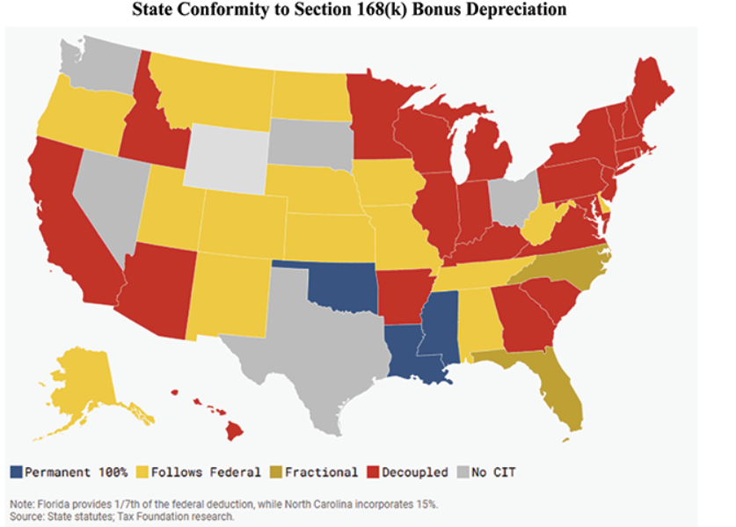
50-State Conformity Hot Spots:

Slide 18
Qualified Business Income Deduction (QBID) or Section 199A Deduction
20% tax deduction on qualified business income (QBI) for sole proprietors and owners of pass-through entities such as
Partnerships
S Corporations
LLCs
This feature (established in 2018 and extending now permanently with OBBBA) is one reason why US resident business owners commonly prefer income taxed personally
Not Eligible: C corporations, wage income, investment income
Notes:
Calculation is complex and income must be below certain thresholds to qualify for the full deduction
For 2025, the income thresholds are:
Single filers: $197,300
Phase-in range = $50,000 (income from $197,300 to $247,300)
Married filing jointly: $394,600
Phase-in range = $100,000 (income from $394,600 to $494,600)
Specified Service Trades or Businesses (healthcare, law, consulting, athletics) have special rules and it is a lot more limited

Slide 19

Key QBI Deduction Changes
QBI Deduction is now permanent
Expanded Phase-in Ranges now apply
New Minimum Deduction of $400, indexed for inflation
For taxpayers with at least $1,000 of QBI (from one or more businesses)

Slide 20
Qualified Business Income Deduction (QBID)
C corporation vs Pass-through Entity Comparison
The C corporation pays tax at the corporate level at 21% then distributes the after-tax earnings to the owner as a dividend. The dividend is then taxed again at 15%.
Structure | Pre-Tax Income | Total Federal Tax Paid | Net to Owner | Effective Tax Rate
C Corporation | $200,000 | $65,700 | $134,300 | 32.85%
Partnership or S Corporation (QBID Eligible) | $200,000 | $25,815 | $174,185 | 12.91%
Notes:
Comparison of C Corporation vs Pass-Through with QBID
Assumptions:
The owner is married filing jointly
All $200,000 is qualified business income (QBI) for the pass-through
The owner is below the QBID threshold, so no wage/property or specified service trade or business (SSTB) limitations apply
The C corporation distributes all after-tax earnings as a qualified dividend
The owner is not subject to the net investment income tax (NIIT) for simplicity
Only federal income taxes are considered
NOTE UNLIKE IN CANADA, DIVIDENDS ARE NOT INTEGRATED IN THE US, THUS THE DIFFERENCE IN EFFECTIVE TAX RATES

Slide 21
QBI Deduction Example
Example $500,000 of business income
Example with $2,000,000 of business income
Structure | Pre-Tax Income | Total Federal Tax Paid | Net to Owner | Effective Tax Rate
C Corporation | $500,000 | $164,250 | $335,750 | 32.85%
Partnership or S Corporation (QBID) | $500,000 | $85,664 | $414,336 | 17.13%
Structure | Pre-Tax Income | Total Federal Tax Paid | Net to Owner | Effective Tax Rate
C Corporation | $2,000,000 | $796,040 | $1,203,960 | 32.85%
Partnership or S Corporation (QBID) | $2,000,000 | $592,000 | $1,408,000 | 29.60%

Slide 22

Strategic Recommendations
Review U.S. tax exposure under new rules.
Structuring of inbound to US business.
Branch/Corporation/LP (LLC and S-Corporation generally not advisable)
Model impact of cross-border cash flows (management fees, interest and loan repayments, dividends).
Review application of US-Canada Treaty
Notes:
Remember to consider other factors on the US side rather than just income tax
Estate/death tax
Social security taxes
Type of entity that makes it easier to get visa?
Operating business vs real estate business
# of co owners and method of sharing profits/losses
Desire to keep reinvesting profits vs pulling lots of $ out each year
Transfer pricing
Withholding taxes
Privacy for the foreign upstream owner from US income tax exposure
Ability to flow through losses
Treaty benefits
Owning a business with a mix of US resident owners and Cdn resident owners

Slide 23
Next Steps & Resources
Stay alert for technical corrections or state-level adjustments
Notes:
Also, much of this legislation will need regulations and guidance to flesh out the “question areas” – sometimes that can take more than a year to come out (but shouldn’t be as bad as TCJA)

Slide 24
Impact - US Tariffs
What Foreign Investors and Canadian Companies Need to Know About US Tariffs

Slide 25
Current Rules of the Game
Things have been changing seemingly every week
The Supreme Court will soon consider whether the reciprocal tariffs are legal.
If the Supreme Court rules them illegal, many companies could be eligible for refunds of duties.
The Court is set to hear the Trump administration’s tariffs appeal on an expedited basis - hearings started in Nov 2025
Vast implications for the economy and presidential power
Notes:
The U.S. Court of Appeals for the Federal Circuit ruled against the administration Aug. 29, reasoning that the federal law invoked by President Donald Trump didn’t give him the authority he claimed. The circuit court kept its ruling on hold to provide a chance to appeal. The administration did so, asking the justices to hear the case on an expedited timeline. The justices agreed to that.

Slide 26
Current Rules of the Game
Canada-US trade relations are currently strained by new tariffs, but trade between the two countries remains mostly tariff-free due to the USMCA/CUSMA agreement (over 85% of trade)
As of late August 2025, Canada has removed retaliatory tariffs on most U.S. goods, effective September 1st, 2025, due to the U.S. allowing CUSMA-compliant goods tariff-free entry
Tariffs and counter-tariffs on steel, aluminum, autos, and lumber remain in place pending ongoing negotiations
Tariffs are generally calculated as a percentage of the inventory transaction value declared at the border
Notes:
CUSMA (Canada-United States-Mexico Agreement)
The more the inventory is improved abroad, generally the higher the transaction value
Part of the underlying logic of the administration’s position is get more improvement of inventory (mfg) happening in the US

Slide 27
Strategy – Trade & Duty Programs
Ensure the company supply chain, input sourcing, and manufacturing processes satisfy the origin rules in the CUSMA/USMCA trade agreements to qualify for tariff relief
Reclaiming duties paid on imported goods that are subsequently re-exported (duty drawback)
Utilizing Foreign Trade Zones to defer tariffs on imported goods before they enter the domestic market
Notes:
To maximize benefits from duty drawback, businesses should establish robust tracking systems to monitor the movement of goods and ensure compliance with all filing requirements. This includes maintaining accurate records of import and export transactions and understanding the timelines for filing drawback claims
There are risks with all of these strategies of course. Resist temptation to violate customs rules. Added admin costs, time and capital may be required. Overpricing may damage competitiveness with buyers resisting and pushing negotiations
FTZs offer significant cash flow benefits by allowing companies to defer customs duties on imported goods, with the added benefit of saving entry filing fees.
Goods can be stored, processed, or assembled in an FTZ without incurring duties until they enter U.S. commerce. This can improve liquidity and reduce carrying costs for inventory. To take full advantage of FTZs, companies should evaluate their supply chain operations to identify opportunities for utilizing these zones and ensure compliance with all FTZ regulations, including physical security and recordkeeping requirements.

Slide 28




Third Party Resources
Customs and Duties Experts
Transfer Pricing Experts
Trade Law Attorneys

Slide 29
Impact - WA State and Local Tax
Focus on Washington State and Local Tax (SALT)

Slide 30
2025 Washington Bills Signed Into Law
House Bill 2081: B&O Tax Rate Increases – various dates beginning October 1, 2025
House Bill 2020: New B&O Tax Classification for Payment Card Processing – effective January 1, 2026
Senate Bill 5813: Capital Gains and Estate Tax Increases – Capital Gains portion retroactively effective January 1, 2025. Estate Tax Increase effective July 1, 2025
Senate Bill 5814: Sales & Use Tax and B&O Base Expansion – effective October 1, 2025

Slide 31
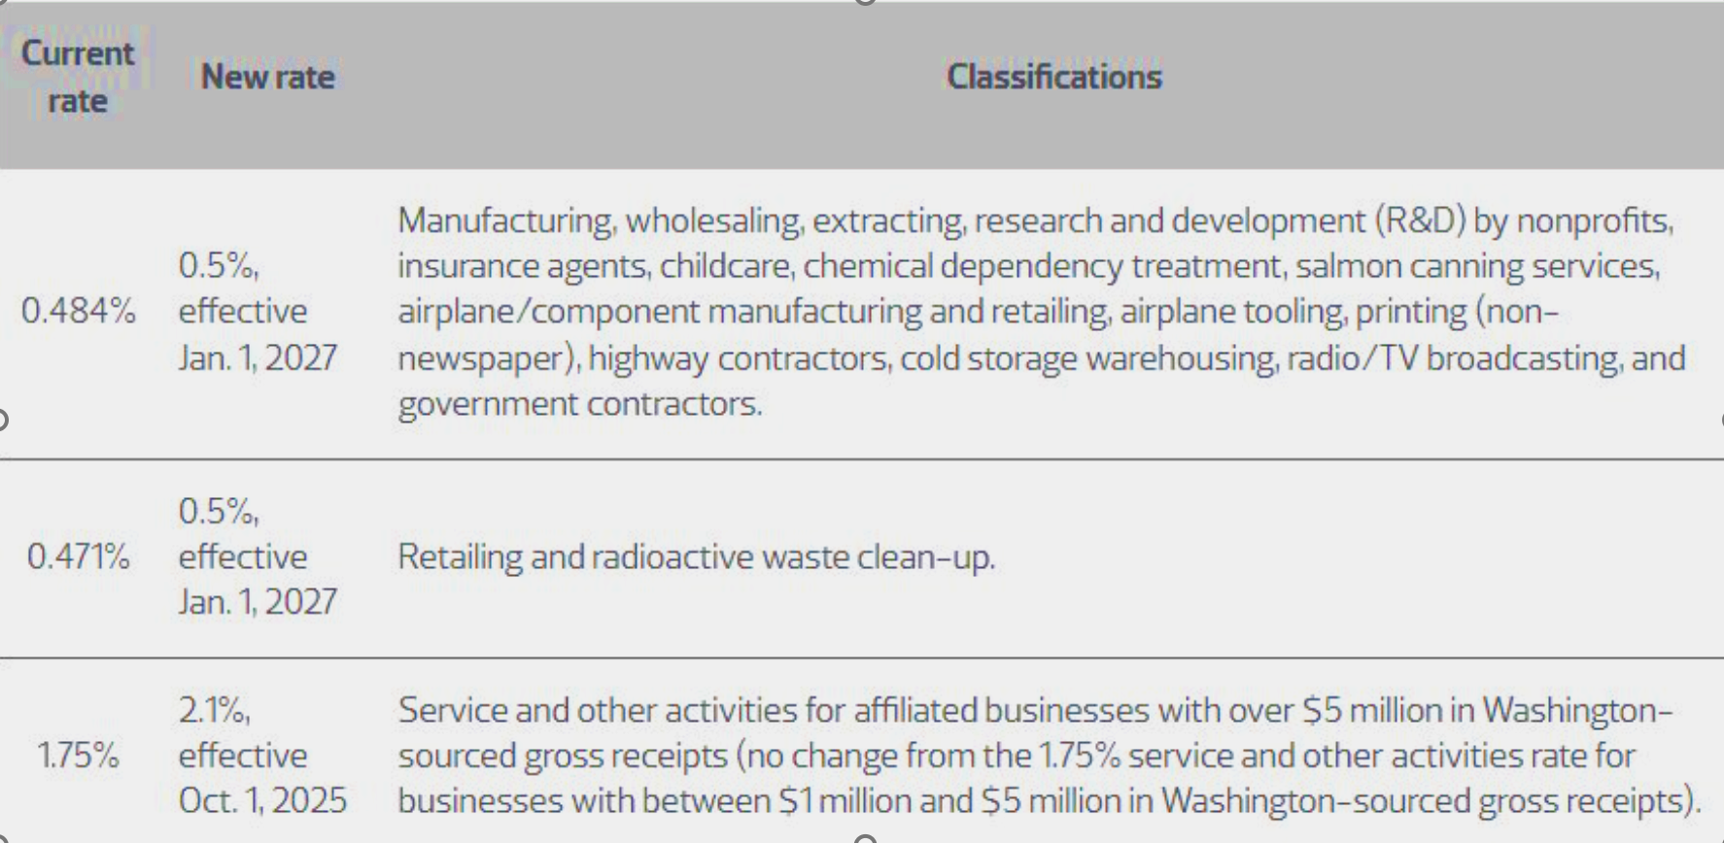
Washington B&O – Rate Increases cont.

Slide 32
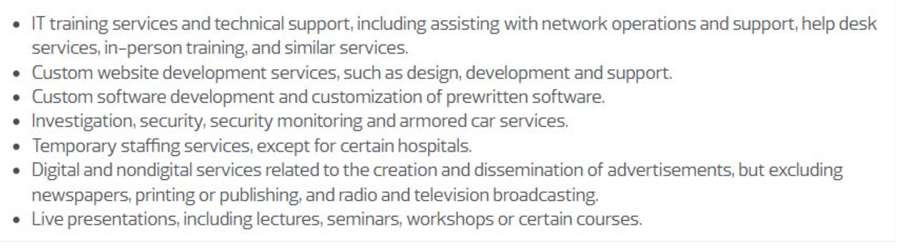
New Sales Tax on Professional Services
Senate Bill 5814, effective Oct. 1, 2025
The following services now fall under the definition of ‘retail sales’:

Slide 33
State and Local Income Tax

Slide 34
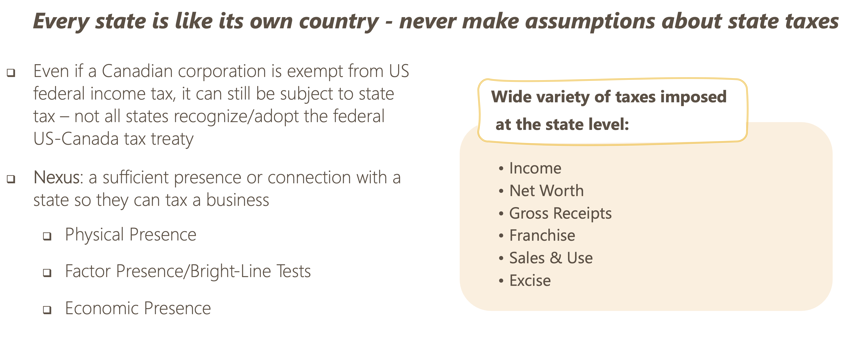
State & Local Taxes (SALT) Overview
Notes:
Haley:
•Every time we advise Cdn entities coming into the US, we let them know that each US state operates like its own country when it comes to taxes. Best to NEVER make assumptions from state-to-state.
•To tie back to Laura’s slides, even if a Cdn corp is exempt from US fed income tax via the treaty, it can still be subject to US taxes at the state level
•So the first crucial concept to understand is “Nexus” = a sufficient presence or connection with a state that allows that jurisdiction to tax a business
•Each state has different rules about what constitutes nexus – COMMON THEME
•Nexus standards differ for different types of tax – for example sales/use standards likely not the same as income tax
•Most common nexus standards are physical presence, factor presence/bright-line tests, and economic presence:
•Physical presence = tangible presence in a state – employees, independent contractors, inventory, equipment, real estate, etc. If you have physical presence in a state its generally pretty clear-cut that you have nexus
•Factor Presence/Bright-Line = if business has X dollar of sales, payroll or property in a state they have nexus. Thresholds can be updated annually to reflect inflation
•Economic nexus = having sales into a state/”doing business” in a state. Very broad standard and no clear defining boundaries/limits on nexus. Filing determinations are highly subjective and must weigh risks against costs of compliance
•Many different types of taxes imposed at the state level – see list. Focusing on income tax & sales/use tax in this presentation

Slide 35
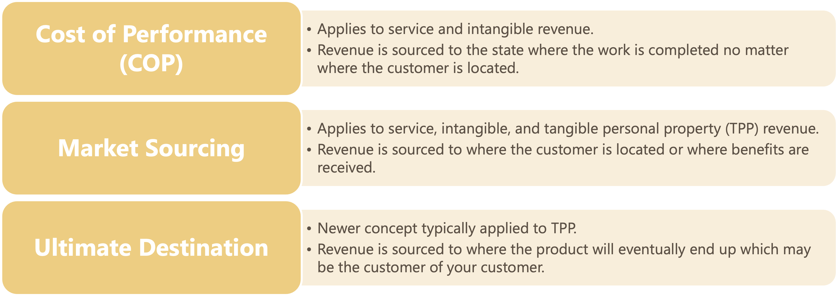

State Income Sourcing Rules
Notes:
Haley:
•Note that state income sourcing rules typically do not match federal rules
•Rules vary from state-to-state – 3 most common shown here:
•Cost of performance:
•Can apply to service and intangible revenue
•Rev is sourced to state where work is completed regardless of where the customer is located
•Market sourcing:
•Can apply to service, intangible, and TPP revenue (like sales of inventory)
•Rev is sourced to state where customer is located or where benefits are received
•Ultimate destination:
•Newer concept typically applied to TPP revenue
•Rev is sourced to where the product will eventually end up, which may be the customer of your customer
•Trends: use of COP is declining; more states are adopting market sourcing (most common)
•Biggest takeaway is that clients should keep track of their revenue based on customer location so we can advise on SALT risks

Slide 36
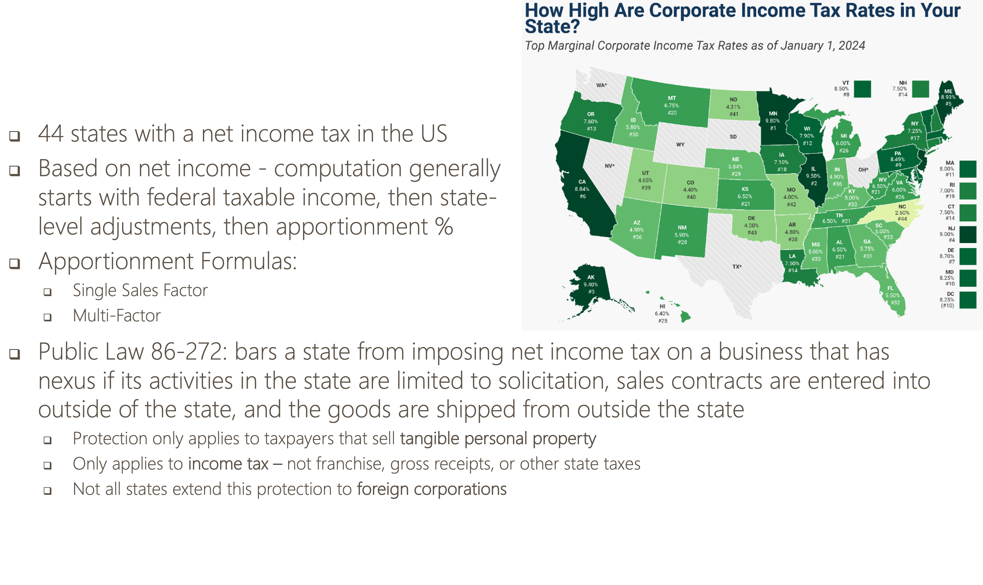
State Income Tax
Notes:
Haley:
•Majority of US states impose a corporate income tax (2024 corp tax rates on map, darker states = higher rates)
•Even some cities have a separate income tax – like NYC
•Computation of income tax generally starts with federal taxable income, then state level adjustments applied for state diffs from fed, then apportionment % applied to determine income subject to state tax rate
•A couple ways to determine apportionment % - again this varies across states
•SSF = method based on just sales to determine the % of profits apportionable to a state
•Multi-factor = based on sales, payroll, and property to determine % of profits apportionable to a state. Sales factor in formula is often weighted
•Public Law 86-272 is another protection we often use – bars state from imposing income tax on a business that has nexus if its activities are limited to solicitation, the contracts for any sales are entered into outside of the state, and the goods are shipped from outside the state
•Only applies to businesses selling TPP
•Only applies to income tax
•Not all states grant this protection to non-US entities
•Note Cdn corps should be able to claim FTC on the Cdn return for state income taxes paid
•Note that if you need transcripts to substantiate the FTC for state income taxes to the CRA…good luck

Slide 37
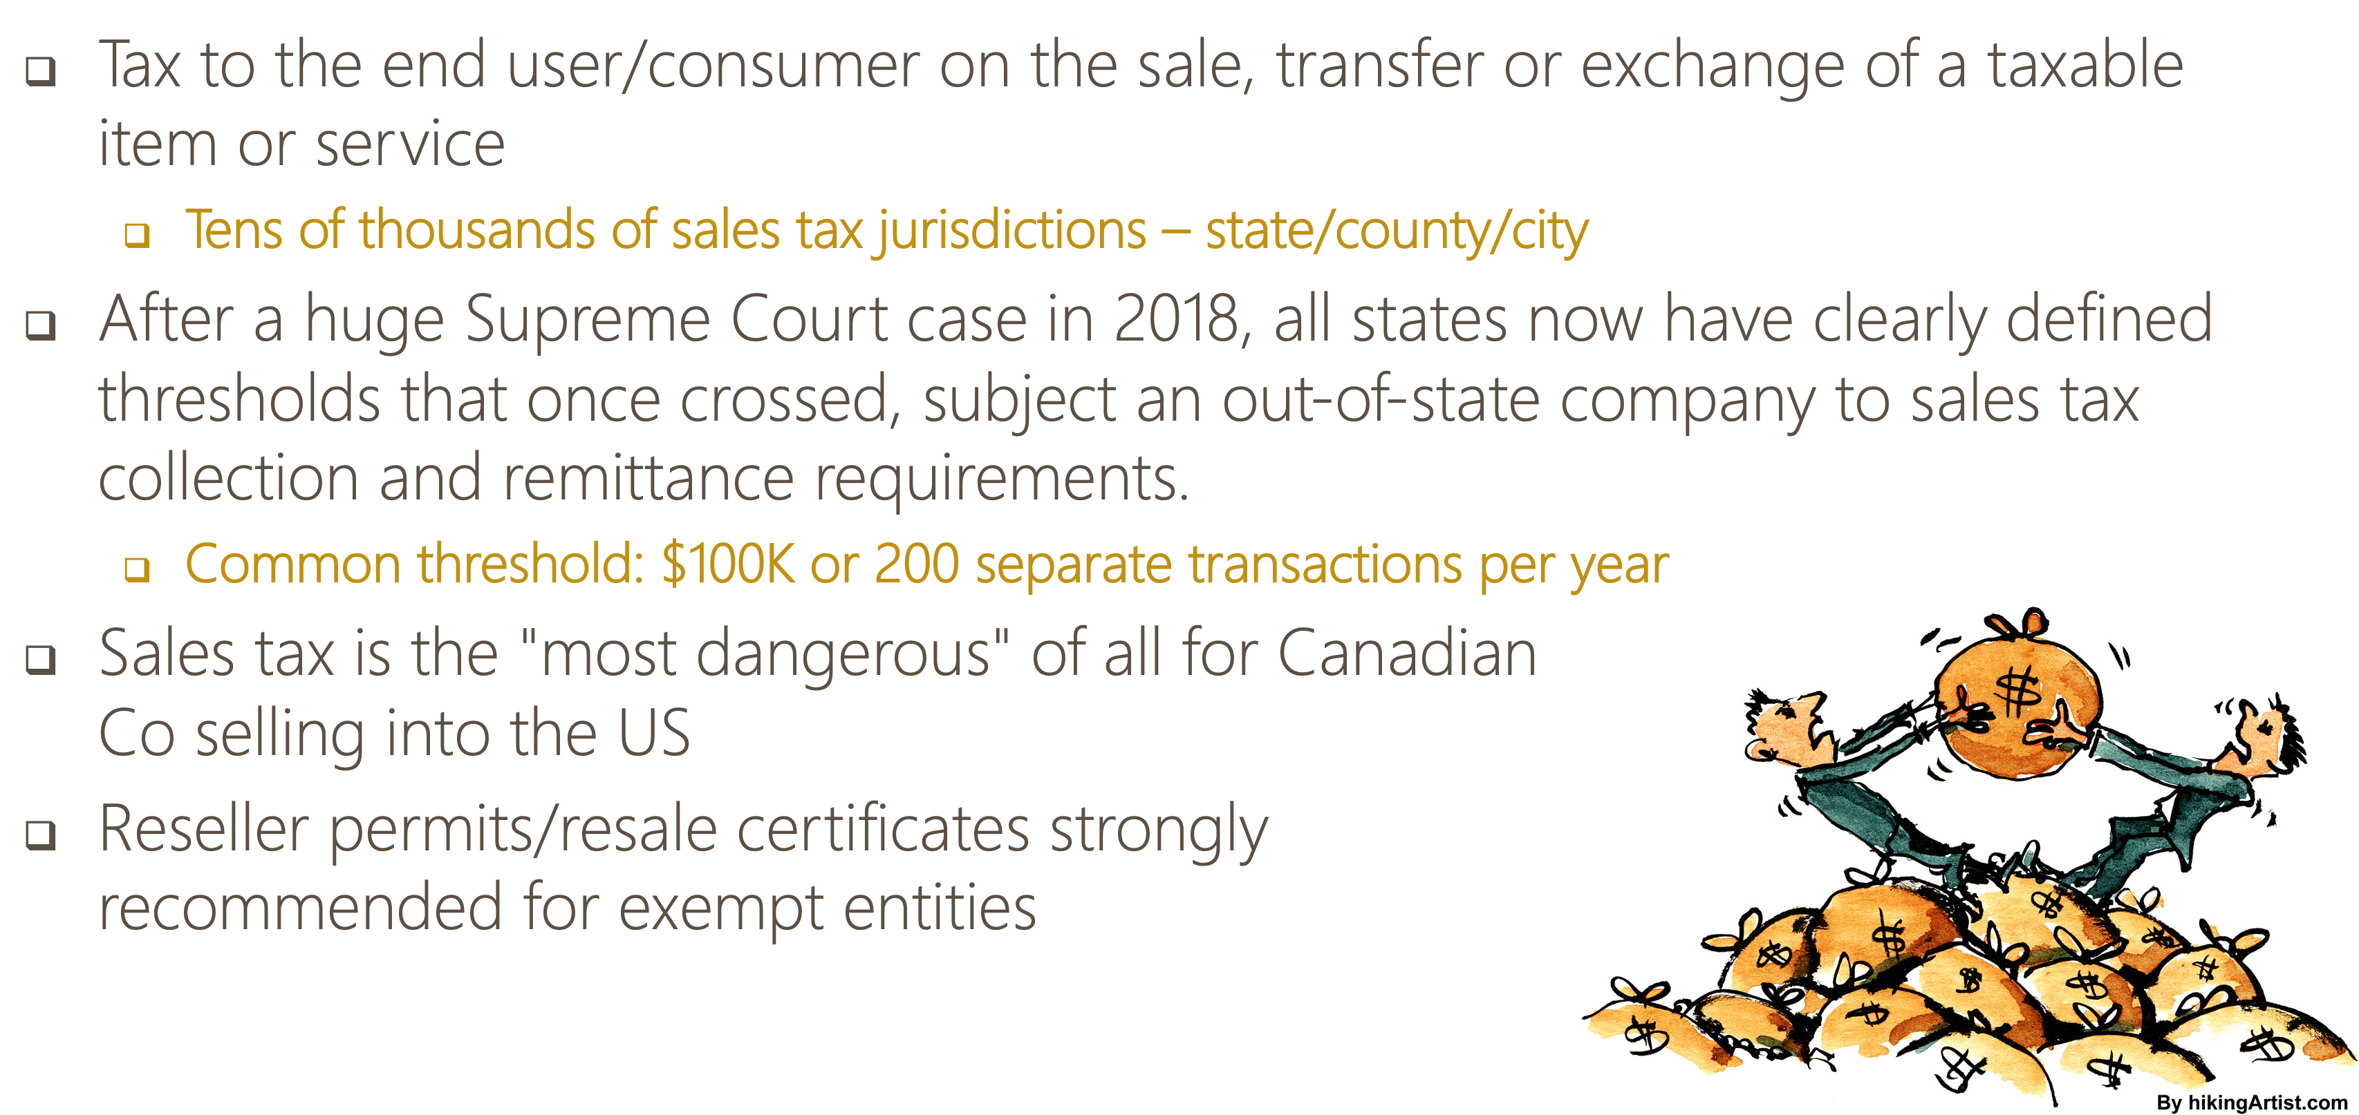
State Sales/Use Tax
Notes:
Haley:
•This is a tax to the end user/consumer on the sale of a taxable item/service (think retail, not wholesales)
•Services are not typically subject to sales tax, but not always the case
•Rentals can even be subject to sales tax
•Over 30K sales tax jurisdictions – can be imposed at state/county/city level
•Range of 2024 combined (state & local) sales tax rates (for states that impose): 1.82% - 9.56%
•Our firm is not specialized in sales tax, nor do we prepare these filings for clients, have 3rd party boutique firm that we refer our clients to
•All states have clearly defined thresholds that once crossed, subject an out-of-state company to sales tax collection & remittance requirements
•Highlighting sales/use tax because this can be one of the most dangerous of all state-level taxes for Cdn Co’s w/ US activity
•Noncompliance can result in huge tax bills because the tax rate is high and if the company doesn’t collect from customers at time of sale, they’re on the line to pay the tax!
•Even if you know your transactions aren’t subject to sales tax, we advise that wholesalers/suppliers request reseller permits from customers to prove this should a state ever come after you for it
Watch market place facilitators, they might be collecting and remitting for you
Talk about companies like Avalra and Sales Jar

Slide 38
Other Important State Topics
Payroll Taxes
Important when opening up US sub
Don't want to fall behind
State and Federal
Property Taxes
Not only real estate, but personal property as well
Applies to businesses, on assets involved in income generation
Could be many exemptions
Voluntary Disclosure Programs
Helpful in getting caught up, reduce penalties, historical exposure
Sales and Income Taxes
Notes:
Haley:
•This is a tax to the end user/consumer on the sale of a taxable item/service (think retail, not wholesales)
•Services are not typically subject to sales tax, but not always the case
•Rentals can even be subject to sales tax
•Over 30K sales tax jurisdictions – can be imposed at state/county/city level
•Range of 2024 combined (state & local) sales tax rates (for states that impose): 1.82% - 9.56%
•Our firm is not specialized in sales tax, nor do we prepare these filings for clients, have 3rd party boutique firm that we refer our clients to
•All states have clearly defined thresholds that once crossed, subject an out-of-state company to sales tax collection & remittance requirements
•Highlighting sales/use tax because this can be one of the most dangerous of all state-level taxes for Cdn Co’s w/ US activity
•Noncompliance can result in huge tax bills because the tax rate is high and if the company doesn’t collect from customers at time of sale, they’re on the line to pay the tax!
•Even if you know your transactions aren’t subject to sales tax, we advise that wholesalers/suppliers request reseller permits from customers to prove this should a state ever come after you for it

Slide 39
Strategy for Canadian CPAs
Know what your client is doing in the US
q Before too much time has gone by!
q Beware of intercompany transactions and timely filings
q Include certain questions in your annual business questionnaire or as part of tax planning?
q Physical presence of inventory, use of contractors, warehouses where inventory is stored, real estate, etc?
q Volume of sales, broken down by state?
q Title transfer on sale of goods to US customers – in what country does it transfer?
q Plans for future expansion?
Notes:
If too much time goes by, then the Canadian can be looking at penalties, voluntary disclosures, back taxes, interest, etc.
Watch for US sourced income or concentrations of revenue from a particular customer in the US
Watch for expansion plans, purchases of US businesses
Watch for people going down into the US to do things after they have a visa

