Slide 1

Managing Stress in Uncertain Environments
Lessons from the Streets to the Spreadsheets

Slide 2
A Warm Welcome from an Unlikely Source
I spent 20 years as a police officer, which means I spent two decades managing chaos… and paperwork. Now I'm talking to accountants, so I'm finally with people who actually like paperwork.
Today's mission: Share practical, battle-tested strategies for managing stress—backed by lived experience from high-stakes policing and solid psychology research.
Because whether you're responding to a 3 a.m. emergency call or a client's panicked email about their tax bill, the stress response is remarkably similar.
We're living through 2025's perfect storm: interest rates dancing unpredictably, tax laws shifting overnight, AI threatening to automate half our workflows, and audit season looming like a dark cloud.

Slide 3


Two Worlds, One Universal Truth
Police Reality
Accounting Reality
Constant uncertainty, threat of harm, shifting priorities minute by minute, life-or-death decisions with incomplete information.
Markets fluctuate wildly, clients panic over portfolios, regulators change rules overnight, compliance deadlines that don't negotiate.
"When a cop screws up paperwork, the bad guy goes free. When you screw up paperwork, CRA shows up—both equally terrifying."

Slide 4


Slide 5

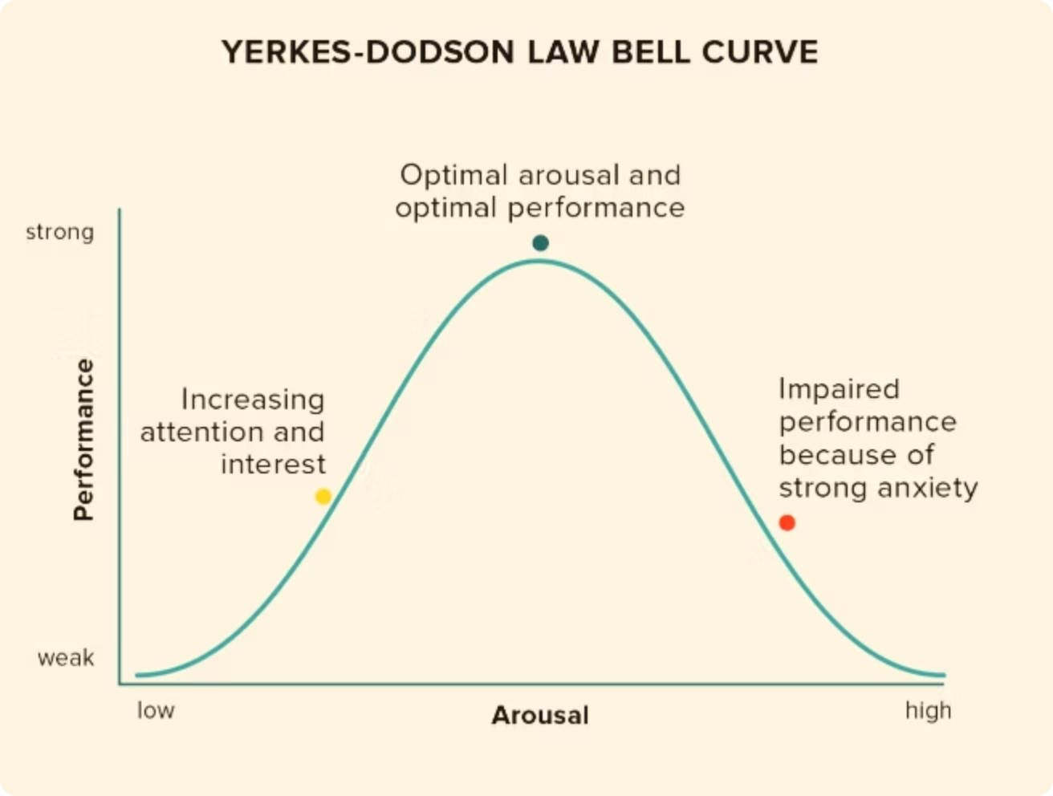
Why Stress Matters
It is inevitable in High-Stakes and High-Trust environments
The right amount of stress actually improves performance and cognition
Understanding stress
=
Managing Stress

Slide 6


The "Routine" Call That Wasn't
Picture this: You respond to what dispatch calls a "routine noise complaint." You arrive, knock on the door, and suddenly you're mediating a domestic dispute with weapons involved. Everything changed in 30 seconds.
Your context: You open an audit file expecting straightforward financials. Three hours later, you've uncovered potential fraud, missing invoices, and a client who's suddenly "unavailable."
The common thread: Both professions demand that you stay calm, think clearly, and make sound decisions precisely when everyone else is losing their minds.

Slide 7

When Your Brain Betrays You Under Pressure
The Physiology of Panic
When stress hits, your body floods with cortisol. Your vision literally narrows—tunnel vision isn't a metaphor. Blood flow redirects from your prefrontal cortex (the part that does math and logic) to your limbs (the part that runs away).
This worked great for our ancestors' facing predators. It's less helpful when you're facing a spreadsheet discrepancy or a demanding client.
Result: Impaired decision-making exactly when you need clarity most.

Slide 8

The Backpack Metaphor
01
02
Every Chaotic Incident = One Rock
The Rocks Accumulate
You don't notice the first few. By month three of tax season, you're carrying 40 pounds of unprocessed stress—and wondering why your back hurts.
For police: violent calls, traumatic scenes, administrative failures. For accountants: market crashes, angry clients, regulatory changes, impossible deadlines.
03
Unmanaged Load = Breakdown
Burnout. Errors. Resentment. Health problems. The backpack doesn't empty itself—you have to consciously unload it.

Slide 9




Your Stress Management Toolkit
Breathing & Grounding
Cognitive Reframing
Routine & Preparation
Micro-Recoveries
Box breathing (4-4-4-4) activates your parasympathetic nervous system. Used in crisis negotiation—equally effective before client presentations.
Shift your internal dialogue: "This isn't a threat, it's a problem to solve." Your nervous system responds to the story you tell yourself.
In policing, gear checks save lives. In accounting, double-checking formulas saves your sanity. Preparation creates psychological safety.
Five-minute walks. Genuine lunch breaks. Regulate stress before it compounds into something unmanageable.

Slide 10



The Power of Strategic Humour
"Cops use dark humour to process trauma. Accountants use sarcasm and coffee mug slogans. Both work—because laughter physiologically reduces cortisol."
Humour isn't frivolous—it's a legitimate resilience tool. It creates psychological distance from stressors, builds team cohesion, and signals to your nervous system that you're safe enough to laugh.
Find your version: memes, inside jokes with colleagues, or just acknowledging the absurdity of asking clients for receipts from 2019.

Slide 11



Navigating 2025's Uncertainty
Market Volatility
AI Disruption
Regulatory Changes
Global instability, tariffs, fluctuating interest rates, crypto crashes—financial landscapes shift faster than ever.
Automation threatens traditional workflows while creating new opportunities—and new anxieties about relevance.
Tax codes evolve, uncertainty around federal budget, compliance requirements multiply, and staying current feels like a full-time job on top of your full-time job.
Here's the truth: uncertainty isn't new. Policing has always faced evolving threats and technology. What matters isn't eliminating uncertainty—it's managing your response to it.

Slide 12
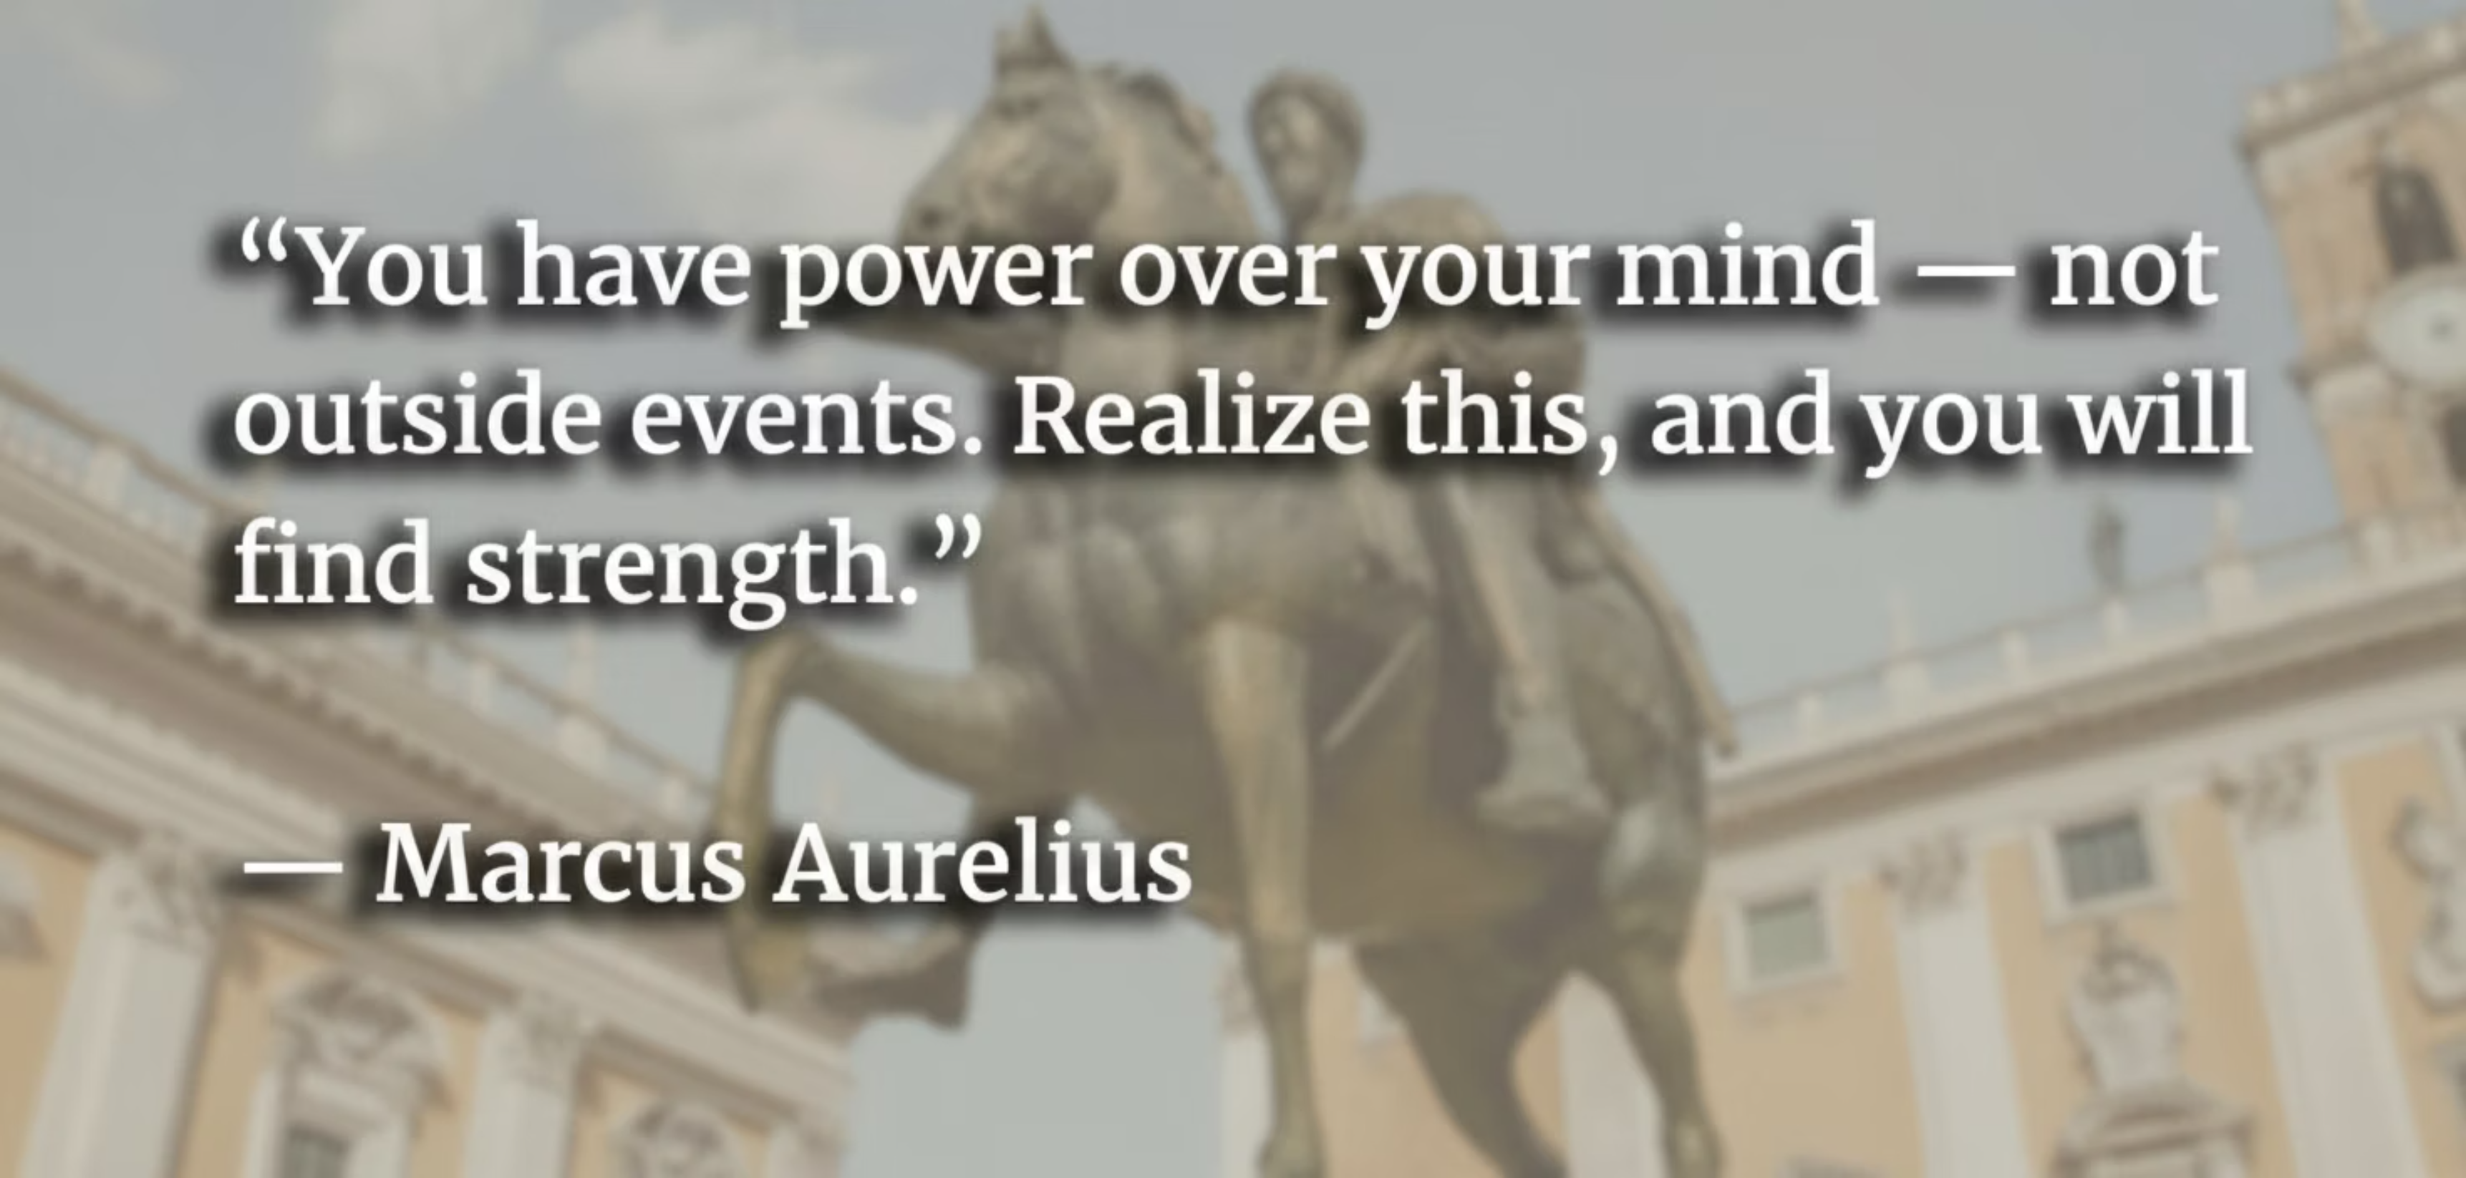

Slide 13

Your One-Week Challenge
Remember This
Managing stress doesn't mean eliminating it. It means carrying the load wisely, unloading regularly, and building resilience for the long haul.
Take Action Today
Choose one strategy from today and implement it this week. Just one. Box breathing before meetings. A five-minute walk at lunch. Reframing one stressor as a solvable problem.
"In policing, we say the job is hours of boredom punctuated by moments of sheer terror. In accounting, it's hours of spreadsheets punctuated by clients asking, 'Can you make me pay less tax?' Either way—stress management is the key to survival."

Slide 14

Thank You!
Mike Willford, Sgt. (Ret.), B.A. (Crim/Policing)
Co-Founder | VRFY
mike@vrfyinc.com | www.vrfyinc.com

